Slide 1

SOFTWARE ENGINEERING
Week 5
Requirements Engineering

Slide 2
Agenda
System Engineering
Requirements Engineering
Requirement Engineering Processes

Slide 3

System Engineering
System Engineering
Requirements Engineering
Requirement Engineering Processes
The Case Study

Slide 4
System Engineering
Elements of a computer-based system
Software
Hardware
People
Database
Documentation
Procedures
Systems
A hierarchy of macro-elements

Slide 5
The Hierarchy

Slide 6
Requirements Engineering
System Engineering
Requirements Engineering
Requirement Engineering Processes
The Case Study

Slide 7
Requirement Engineering
The process of establishing the services that the customer requires from a system and the constraints under which it operates and is developed.
The requirements themselves are the descriptions of the system services and constraints that are generated during the requirements engineering process.
Notes:
The current situation
The functionality the new system should support
The environment in which the system will be deployed
Deliverables expected by the client
Delivery dates
A set of acceptance criteria

Slide 8
Types of Requirement
User requirements
Statements in natural language plus diagrams of the services that the system provides and its operational constraints. Written for customers.
System requirements
A structured document setting out detailed descriptions of the system’s functions, services and operational constraints. Defines what should be implemented so may be part of a contract between client and contractor.
Notes:
Very challenging activity
Requires collaboration of people with different backgrounds
Users with application domain knowledge
Developer with solution domain knowledge (design knowledge, implementation knowledge)
Bridging the gap between user and developer:
Scenarios: Example of the use of the system in terms of a series of interactions with between the user and the system
Use cases: Abstraction that describes a class of scenarios

Slide 9
User and System Requirements

Slide 10
Users of Requirements

Slide 11
Functional and Non-functional Requirements
Functional requirements
Statements of services the system should provide, how the system should react to particular inputs and how the system should behave in particular situations.
May state what the system should not do.
Non-functional requirements
Constraints on the services or functions offered by the system such as timing constraints, constraints on the development process, standards, etc.
Often apply to the system as a whole rather than individual features or services.
Domain requirements
Constraints on the system from the domain of operation
Notes:
EXAMPLE FUNC REQ: Calculate the discount at the rate of 14% for a customer spending amount
o Number of significant digits to which accuracy should be maintained in all numerical calculations is 4
o A book can be deleted from the Library Management System by the Database Administrator only
NONFUNC REQ: The response time of the system should always be less than 5seconds
o The software should operate on a UNIX based system
o Experienced officers should be able to use all the system functions after a total training of two hours. After this training, the average number of errors made by experienced officers should not exceed two per day

Slide 12
What is usually NOT in requirements?
System structure, implementation technology
Development methodology
Development environment
Implementation language
Reusability

Slide 13
Types of Non-functional Requirements

Slide 14
Requirements Specification
The process of writing down the user and system requirements in a requirements document.
User requirements have to be understandable by end-users and customers who do not have a technical background.
System requirements are more detailed requirements and may include more technical information.
The requirements may be part of a contract for the system development
It is therefore important that these are as complete as possible.

Slide 15
Guidelines For Writing Requirements
Invent a standard format and use it for all requirements.
Assign a unique number and source (mostly people) for each requirement.
Use language in a consistent way. Use shall for mandatory requirements, should for desirable requirements.
Use text highlighting to identify key parts of the requirement.
Avoid the use of computer jargon.
Include an explanation (rationale) of why a requirement is necessary.

Slide 16
An Example Requirement Document
Click here for an example requirements document.

Slide 17
Requirements Engineering Processes
System Engineering
Requirements Engineering
Requirements Engineering Processes
The Case Study

Slide 18
Requirements Engineering Processes
Inception—ask a set of questions that establish the following:
basic understanding of the problem
the people who want a solution
the nature of the solution that is desired, and
the effectiveness of preliminary communication and collaboration between the customer and the developer
Elicitation—elicit requirements from all stakeholders
Elaboration—create an analysis model that identifies data, function and behavioral requirements
Negotiation—agree on a deliverable system that is realistic for developers and customers
Specification—can be any one (or more) of the following:
A written document
A set of models
A formal mathematical
A collection of user scenarios (use-cases)
A prototype
Validation—a review mechanism that looks for
errors in content or interpretation
areas where clarification may be required
missing information
inconsistencies (a major problem when large products or systems are engineered)
conflicting or unrealistic (unachievable) requirements.
Requirements management

Slide 19
A Spiral View Of The Requirements Engineering Process

Slide 20
Problems Of Requirements Elicitation
Stakeholders don’t know what they really want.
Stakeholders express requirements in their own terms.
Different stakeholders may have conflicting requirements.
Organisational and political factors may influence the system requirements.
The requirements change during the analysis process. New stakeholders may emerge and the business environment may change.

Slide 21
Use Cases
Use case diagrams are used to visualize, specify, construct, and document the (intended) behavior of the system, during requirements capture and analysis.
Provide a way for developers, domain experts and end-users to Communicate.
Serve as basis for testing.
Main authors: Booch, Rumbaugh, and Jacobson
The Object Management Group (OMG) is responsible for standardization. (www.omg.org)
Current version is UML 2.5

Slide 22
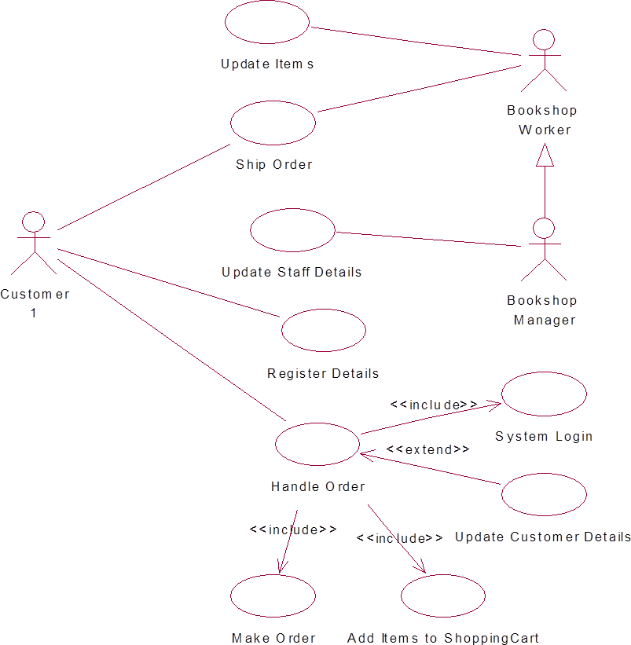
Example : Use Case Diagram
Notes:
AN ACTOR NEED NOT TO BE A HUMAN BEING. EXAMPLE:
An e-commerce information system has to interact with the credit card company information system
The credit card company information system is an actor from the viewpoint of the e-commerce information system
The e-commerce information system is an actor from the viewpoint of the credit card company information system

Slide 23
Example : Use Case (Money Withdraw) - I
Use Case: Withdraw Money
Author: ZB
Date: 1-OCT-2004
Purpose: To withdraw some cash from user’s bank account
Overview: The use case starts when the customer inserts his credit card into the system. The system requests the user PIN. The system validates the PIN. If the validation succeeded, the customer can choose the withdraw operation else alternative 1 – validation failure is executed. The customer enters the amount of cash to withdraw. The system checks the amount of cash in the user account, its credit limit. If the withdraw amount in the range between the current amount + credit limit the system dispense the cash and prints a withdraw receipt, else alternative 2 – amount exceeded is executed.
Cross References: R1.1, R1.2, R7

Slide 24
Example : Use Case (Money Withdraw) - II
Actors: Customer
Pre Condition:
The ATM must be in a state ready to accept transactions
The ATM must have at least some cash on hand that it can dispense
The ATM must have enough paper to print a receipt for at least one transaction
Post Condition:
The current amount of cash in the user account is the amount before the withdraw minus the withdraw amount
A receipt was printed on the withdraw amount
The withdraw transaction was audit in the System log file

Slide 25
Example : Use Case (Money Withdraw) - III
Typical Course of events:
Actor Actions | System Actions
1. Begins when a Customer arrives at ATM
2. Customer inserts a Credit card into ATM | 3. System verifies the customer ID and status
5. Customer chooses “Withdraw” operation | 4. System asks for an operation type
7. Customer enters the cash amount | 6. System asks for the withdraw amount
 | 8. System checks if withdraw amount is legal
 | 9. System dispenses the cash
 | 10. System deduces the withdraw amount from account
 | 11. System prints a receipt
13. Customer takes the cash and the receipt | 12. System ejects the cash card

Slide 26
Example : Use Case (Money Withdraw) - IV
Alternative flow of events:
Step 3: Customer authorization failed. Display an error message, cancel the transaction and eject the card.
Step 8: Customer has insufficient funds in its account. Display an error message, and go to step 6.
Step 8: Customer exceeds its legal amount. Display an error message, and go to step 6.
Exceptional flow of events:
Power failure in the process of the transaction before step 9, cancel the transaction and eject the card

Slide 27
What is a User Story?
Simple, Clear, short description of customer valued functionality
User Stories are an eXtreme Programming technique
This may optionally be used to capture Product Backlog Items
The Product Backlog is a Scrum Artifact
User Stories capture Who, What and Why of any requirement
3Cs – Card, Conversation, Confirmation
Conversation rather than documentation

Slide 28
Leveraging User Roles and Personas
Write story from user’s perspective
Understand the user’s goal for the story
Understand the user’s value from the story
Use human users
Avoid generic “as a user” or “as a customer”
If you have identified Personas, the story could be written from the point of view of this character/user
Notes:
Personas – can be used for outliners
Don’t use the term user or customer, those are very generic, e.g. use frequent flyer.

Slide 29
User Story Template
Title:
Priority:
As a [type of user], I want [goal] so that
[Value]
Notes:
Assumptions:
Constraints:
Estimate:
Notes:
Write them down, be it Notes, Constraints, Risks, Assumptions
No harm and it helps in prioritization, estimation

Slide 30
User Story Example
Checkout Using Credit Card
Priority: 25
As a book shopper, I can checkout using my credit card
So that I can purchase a selected book.
Notes: Support mc, visa, amex
Constraints: Must use SBI payment gateway
Estimate: 13pts
Notes:
UX has to be mentioned in the requirements

Slide 31
Acceptance Criteria
Given [context]
When [some event]
Then [outcome]
Notes:
Behavior Driven Development
As a good P.O. you need to have Acceptance Criteria for every user story

Slide 32
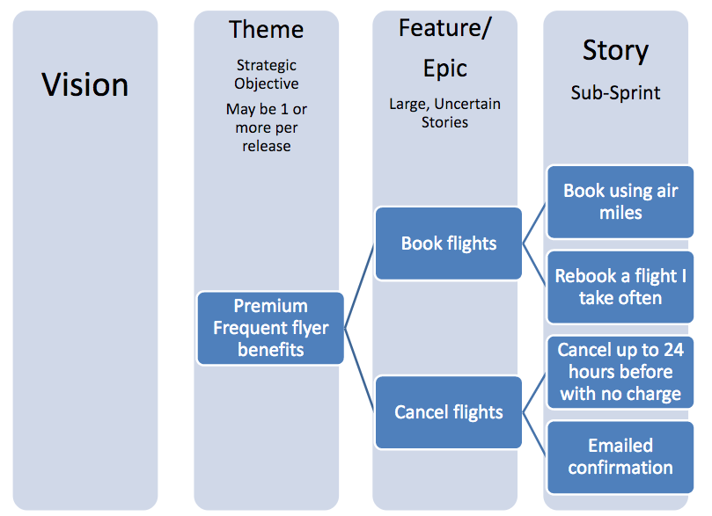
Feature/Epic/User Story

Slide 33
User Story Examples
As a user I want emails with attachments to go faster so that I can work more efficiently
As a user I want to cancel a reservation so that I avoid being charged full rate

Slide 34
Tools For Requirements
OSRMT – Open Source Requirements Management Tool www.sourceforge.net/projects/osrmt
EasyRM – Cybernetic Intelligence www.eary-rm.com
Rational Requisite Pro www.rational.com
OnYourMark - Omni-Vista www.omni-vista.com
RTM – Integratd Chipware www.chipware.com

Slide 35
Supplementary Material
From the Book ‘Object-Oriented Software Engineering: Using UML, Patterns, and Java’ by Bruegge and Detoit

Slide 36
Scenarios
“A narrative description of what people do and experience as they try to make use of computer systems and applications” [M. Carrol, Scenario-based Design, Wiley, 1995]
A concrete, focused, informal description of a single feature of the system used by a single actor.
Scenarios can have many different uses during the software lifecycle
Requirements Elicitation: As-is scenario, visionary scenario
Client Acceptance Test: Evaluation scenario
System Deployment: Training scenario.

Slide 37
Types of Scenarios
As-is scenario:
Used in describing a current situation. Usually used in re-engineering projects. The user describes the system.
Example: Description of Letter-Chess
Visionary scenario:
Used to describe a future system. Usually used in greenfield engineering and reengineering projects.
Can often not be done by the user or developer alone
Example: Description of an interactive internet-based Tic Tac Toe game tournament.
Evaluation scenario:
User tasks against which the system is to be evaluated.
Example: Four users (two novice, two experts) play in a Tic Tac Toe tournament in ARENA.
Training scenario:
Step by step instructions that guide a novice user through a system
Example: How to play Tic Tac Toe in the ARENA Game Framework.

Slide 38
How do we find scenarios?
Don’t expect the client to be verbal if the system does not exist (greenfield engineering)
Don’t wait for information even if the system exists
Engage in a dialectic approach (evolutionary, incremental engineering)
You help the client to formulate the requirements
The client helps you to understand the requirements
The requirements evolve while the scenarios are being developed

Slide 39
Heuristics for finding Scenarios
Ask yourself or the client the following questions:
What are the primary tasks that the system needs to perform?
What data will the actor create, store, change, remove or add in the system?
What external changes does the system need to know about?
What changes or events will the actor of the system need to be informed about?
However, don’t rely on questionnaires alone.
Insist on task observation if the system already exists (interface engineering or reengineering)
Ask to speak to the end user, not just to the software contractor
Expect resistance and try to overcome it

Slide 40
Example: Accident Management System
What needs to be done to report a “Cat in the Tree” incident?
What do you need to do if a person reports “Warehouse on Fire?”
Who is involved in reporting an incident?
What does the system do, if no police cars are available? If the police car has an accident on the way to the “cat in a tree” incident?
What do you need to do if the “Cat in the Tree” turns into a “Grandma has fallen from the Ladder”?
Can the system cope with a simultaneous incident report “Warehouse on Fire?”

Slide 41
Scenario Example: Warehouse on Fire
Bob, driving down main street in his patrol car notices smoke coming out of a warehouse. His partner, Alice, reports the emergency from her car.
Alice enters the address of the building, a brief description of its location (i.e., north west corner), and an emergency level. In addition to a fire unit, she requests several paramedic units on the scene given that area appear to be relatively busy. She confirms her input and waits for an acknowledgment.
John, the Dispatcher, is alerted to the emergency by a beep of his workstation. He reviews the information submitted by Alice and acknowledges the report. He allocates a fire unit and two paramedic units to the Incident site and sends their estimated arrival time (ETA) to Alice.
Alice received the acknowledgment and the ETA.

Slide 42
Observations about Warehouse on Fire Scenario
Concrete scenario
Describes a single instance of reporting a fire incident.
Does not describe all possible situations in which a fire can be reported.
Participating actors
Bob, Alice and John

Slide 43
Next goal, after the scenarios are formulated:
Find all the use cases in the scenario that specifies all possible instances of how to report a fire
Example: “Report Emergency “ in the first paragraph of the scenario is a candidate for a use case
Describe each of these use cases in more detail
Participating actors
Describe the Entry Condition
Describe the Flow of Events
Describe the Exit Condition
Describe Exceptions
Describe Special Requirements (Constraints, Nonfunctional Requirements

Slide 44
Use Cases
A use case is a flow of events in the system, including interaction with actors
It is initiated by an actor
Each use case has a name
Each use case has a termination condition
Graphical Notation: An oval with the name of the use case
ReportEmergency
Use Case Model: The set of all use cases specifying the complete functionality of the system

Slide 45
Example: Use Case Model for Incident Management
FieldOfficer
Dispatcher
OpenIncident
ReportEmergency
AllocateResources

Slide 46
Heuristics: How do I find use cases?
Select a narrow vertical slice of the system (i.e. one scenario)
Discuss it in detail with the user to understand the user’s preferred style of interaction
Select a horizontal slice (i.e. many scenarios) to define the scope of the system.
Discuss the scope with the user
Use illustrative prototypes (mock-ups) as visual support
Find out what the user does
Task observation (Good)
Questionnaires (Bad)

Slide 47
Use Case Example: ReportEmergency
Use case name: ReportEmergency
Participating Actors:
Field Officer (Bob and Alice in the Scenario)
Dispatcher (John in the Scenario)
Exceptions:
The FieldOfficer is notified immediately if the connection between her terminal and the central is lost.
The Dispatcher is notified immediately if the connection between any log in FieldOfficer and the central is lost.
Flow of Events: on next slide.
Special Requirements:
The FieldOfficer’s report is acknowledged within 30 seconds. The selected response arrives no later than 30 seconds after it is sent by the Dispatcher.

Slide 48
Use Case Example: ReportEmergency Flow of Events
The FieldOfficer activates the “Report Emergency” function of her terminal. FRIEND responds by presenting a form to the officer.
The FieldOfficer fills the form, by selecting the emergency level, type, location, and brief description of the situation. The FieldOfficer also describes possible responses to the emergency situation. Once the form is completed, the FieldOfficer submits the form, at which point, the Dispatcher is notified.
The Dispatcher reviews the submitted information and creates an Incident in the database by invoking the OpenIncident use case. The Dispatcher selects a response and acknowledges the emergency report.
The FieldOfficer receives the acknowledgment and the selected response.

Slide 49
Another Use Case Example: Allocate a Resource
Actors:
Field Supervisor: This is the official at the emergency site....
Resource Allocator: The Resource Allocator is responsible for the commitment and de-commitment of the Resources managed by the FRIEND system.
Dispatcher: A Dispatcher enters, updates, and removes Emergency Incidents, Actions, and Requests in the system. The Dispatcher also closes Emergency Incidents.
Field Officer: Reports accidents from the Field

Slide 50
Another Use Case Example: Allocate a Resource
Use case name: AllocateResources
Participating Actors:
Field Officer (Bob and Alice in the Scenario)
Dispatcher (John in the Scenario)
Resource Allocator
Field Supervisor
Entry Condition
The Resource Allocator has selected an available resource.
The resource is currently not allocated
Flow of Events
The Resource Allocator selects an Emergency Incident.
The Resource is committed to the Emergency Incident.
Exit Condition
The use case terminates when the resource is committed.
The selected Resource is now unavailable to any other Emergency Incidents or Resource Requests.
Special Requirements
The Field Supervisor is responsible for managing the Resources

Slide 51
Wrap-up
This week we present
System Engineering: How to model and understand the overall components of a software system
Requirements Engineering: How to manage and acquire the needs of customer
Requirement Process: What phases should be applied in effectively gathering requirements.

Slide 52
Next Week
We will introduce object oriented and classical approaches in Requirements Analysis!!!

